Slide 1
AF detection using transfer learning from ECG to PPG
Snir Lugassy, Guy Hamburger

Slide 2
Goal
Utilizing peak-based models, trained over ECG, using PPG samples in order to predict AF events.
Although PPG is considered less accurate in measuring HRV, we hypothesis that it is still a good approximation is the task of AF detection.

Slide 3
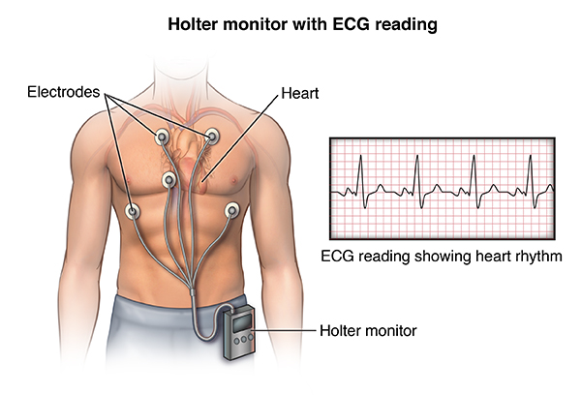
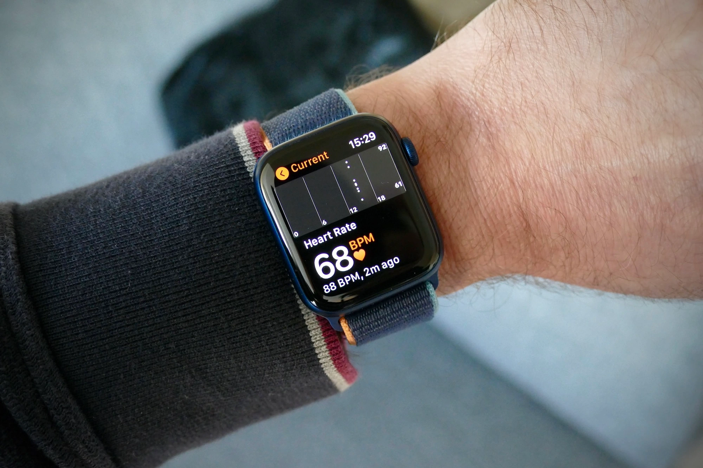
Motivation
Larger datasets to consider using RR (training ECG + PPG)
Accessibility
Comfort

Slide 4
Dataset
The UMass database has been collected at the University of Massachusetts Medical School, approved usage via Synapse.
41 Subjects
9 / 41 with AF
The PPG signal has been recorded from a smart wristwatch provided by Samsung (also known as “Simband”).
Sample length: 38.4 min average
Bashar, et al. Atrial Fibrillation Detection from Wrist Photoplethysmography Signals Using Smartwatches (2019)
https://doi.org/10.1038/s41598-019-49092-2

Slide 5
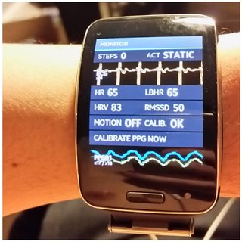
Simband smart watch
Developed by Samsung
Supports WiFi and Bluetooth connections
Cloud integration for data tracking and export
8 PPG leads
1 ECG lead
Accelerometer
2 Bioelectrical Impedance sensors (Bio-Z)
2 GSR sensors (tonic and phasic galvanic skin response)
Skin temperature sensor

Slide 6
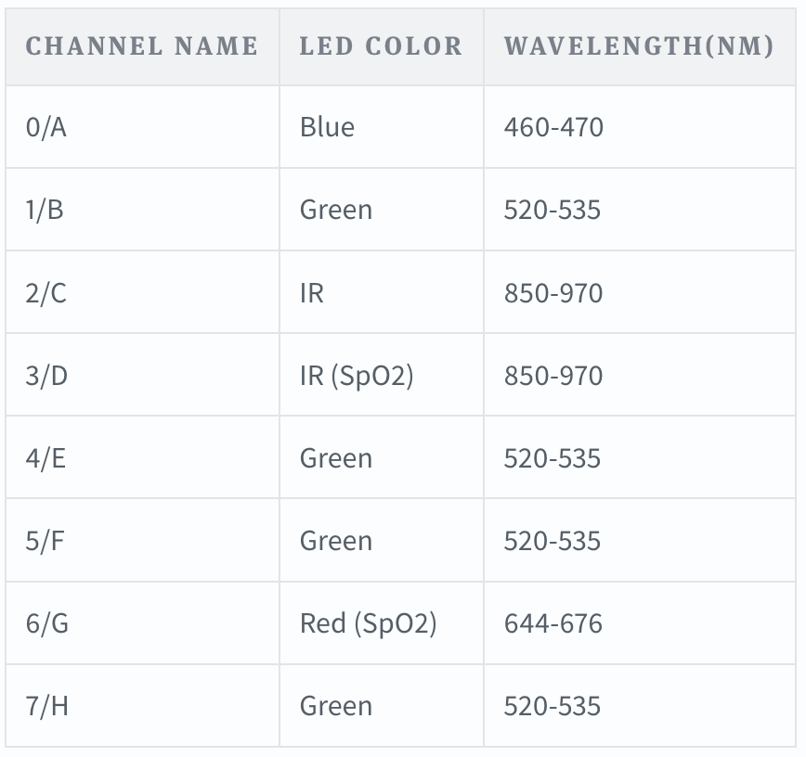
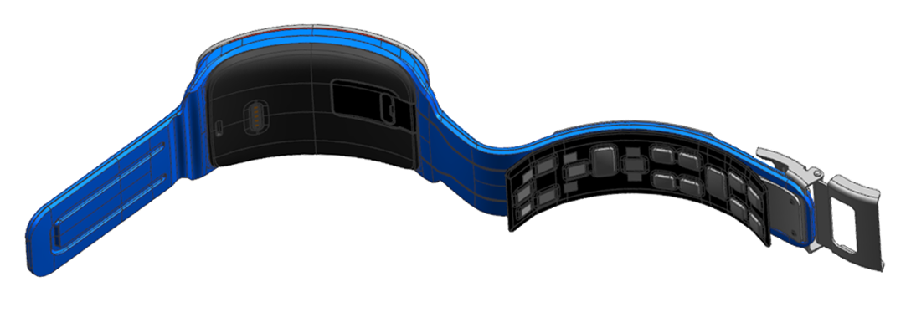
Simband smart watch
Resolution: 14 bits
Sampling frequency: 128 Hz (more values are possible)
PPG downsampled to 50 Hz

Slide 7
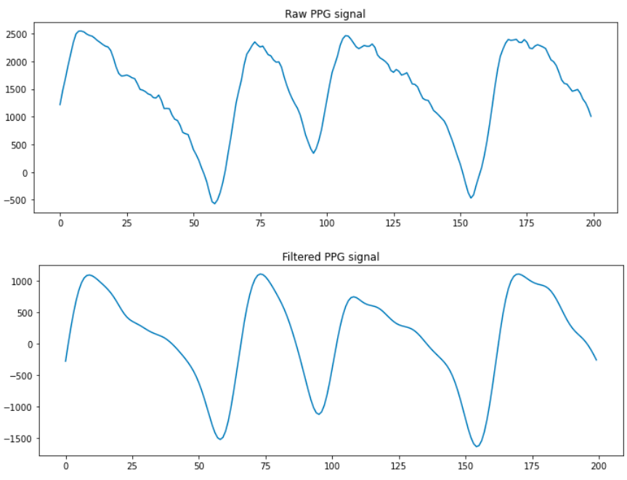
Preprocessing
Bandpass filter: [0.5, 4] Hz (30-240 bpm)

Slide 8
Preprocessing
Windows slicing - according to the ground truth and the pre-trained model

Slide 9
Preprocessing
Peak detection using HeartPy package
Adaptive threshold peak detection using moving average
Outliers detection and removal
ROI selection (where the signal amplitude is larger than the moving average)
Peak position is the highest point in the marked ROI
https://python-heart-rate-analysis-toolkit.readthedocs.io/en/latest/

Slide 10
Preprocessing
Peak detection using Elgendi
Squaring
Generating BOI by using 2 moving average the demarcate systolic and heartbeat areas.
2 Threshold parameters (one for noise blocking, second for diastolic blocks)
Parameter optimization (was obtained through brute-force)
Elgendi M, et al. (2013) Systolic Peak Detection in Acceleration Photoplethysmograms Measured from Emergency Responders in Tropical Conditions
https://doi.org/10.1371/journal.pone.0076585
Notes:
W1/W2 (windows sizes for Moving averages)

Slide 11
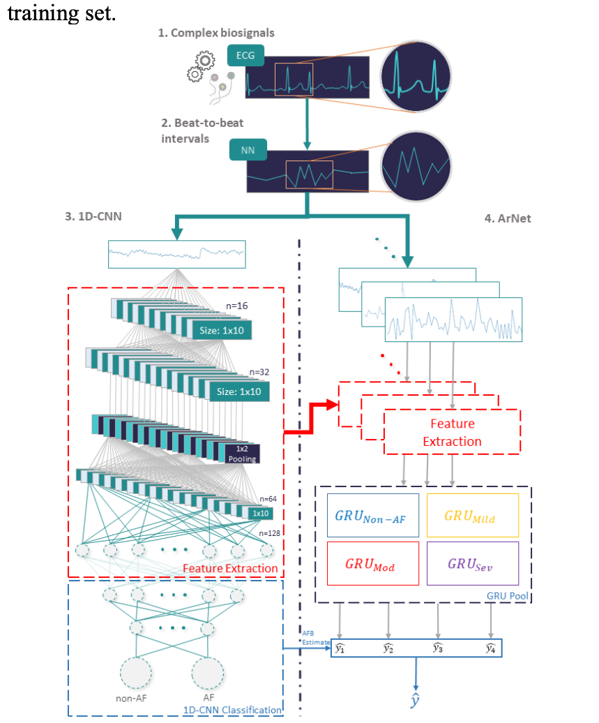
Pre-trained model
Arnet + 1D-CNN
Chocron et al., Remote atrial fibrillation burden estimation using deep recurrent neural network, IEEE, 2020. https://doi.org/10.48550/arXiv.2008.02228

Slide 12
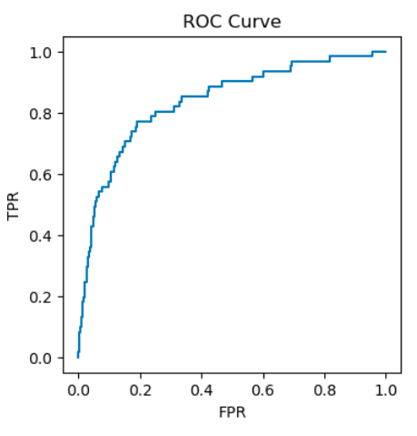
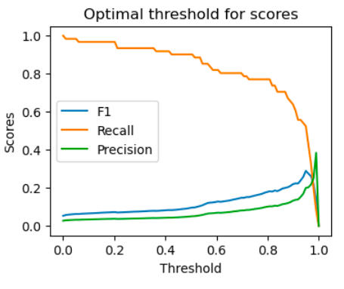
1D-CNN Results HeartPy peak detection
AUC=0.837

Slide 13
1D-CNN Confusion Matrix HeartPy peak detection
 | Predicted AF (PP) | Predicted Non-AF (PN)
AF (P) | 52 | 9
Non-AF (N) | 767 | 1393
Precision TP/PP | 0.063
Recall TP/P | 0.852
F1 2TP/(2TP+FP+FN) | 0.118

Slide 14
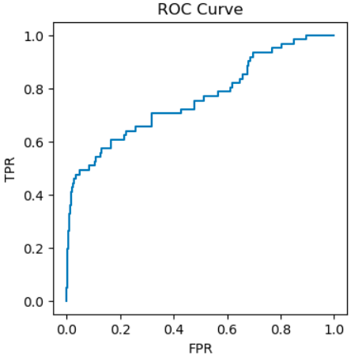
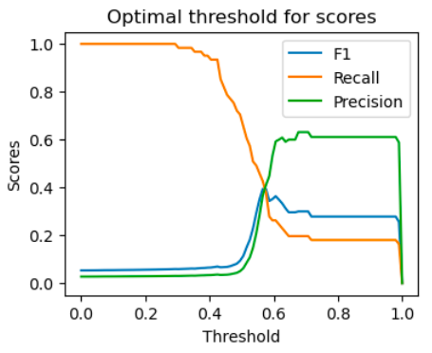
ArNet +1D-CNN Results HeartPy peak detection
AUC=0.761

Slide 15
ArNet + 1D-CNN Confusion Matrix HeartPy peak detection
 | Predicted AF (PP) | Predicted Non-AF (PN)
AF (P) | 37 | 24
Non-AF (N) | 444 | 1716
Precision TP/PP | 0.076
Recall TP/P | 0.606
F1 2TP/(2TP+FP+FN) | 0.136

Slide 16
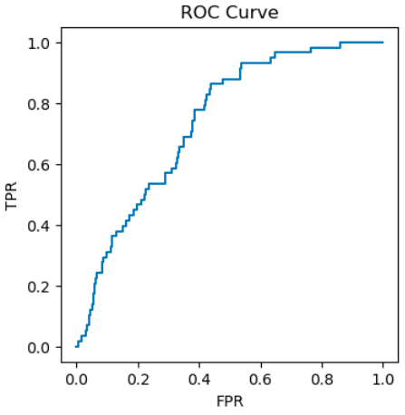
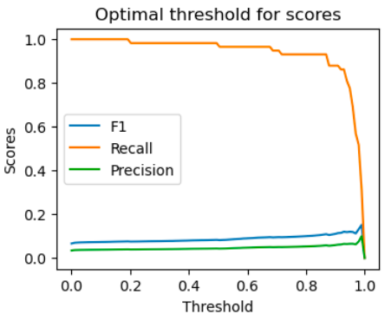
1D-CNN Results Elgendi peak detection
AUC=0.739

Slide 17
1D-CNN Confusion Matrix Elgendi peak detection
 | Predicted AF (PP) | Predicted Non-AF (PN)
AF (P) | 56 | 2
Non-AF (N) | 1184 | 456
Precision TP/PP | 0.0451
Recall TP/P | 0.965
F1 2TP/(2TP+FP+FN) | 0.086

Slide 18
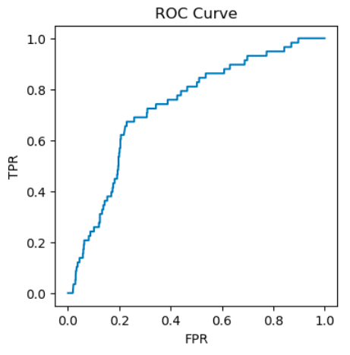
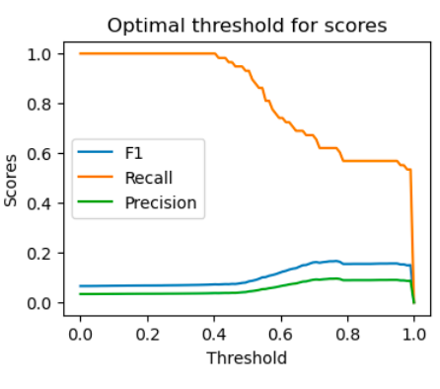
ArNet + 1D-CNN Results Elgendi peak detection
AUC=0.731

Slide 19
ArNet + 1D-CNN Confusion Matrix Elgendi peak detection
 | Predicted AF (PP) | Predicted Non-AF (PN)
AF (P) | 52 | 6
Non-AF (N) | 1098 | 543
Precision TP/PP | 0.045
Recall TP/P | 0.896
F1 2TP/(2TP+FP+FN) | 0.086

Slide 20
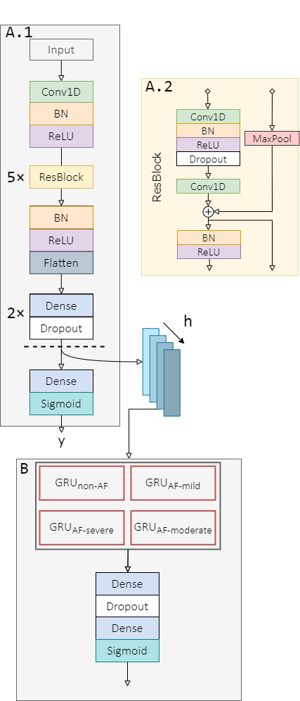
Pre-trained model
ArNet2 + ResNet
Biton et al., generalization performance of deep learning for atrial fibrillation detection from ECG, in preparation

Slide 21
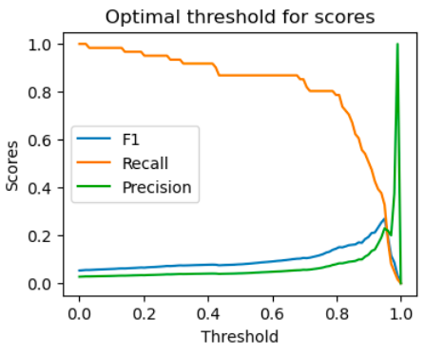
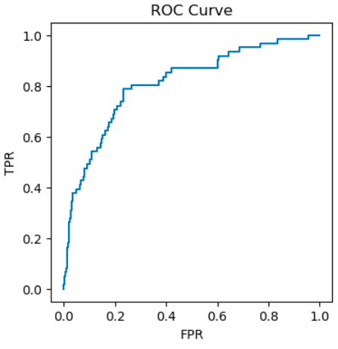
ResNet Results HeartPy peak detection, all windows
AUC=0.811

Slide 22
ResNet Confusion Matrix HeartPy peak detection, all windows
 | Predicted AF (PP) | Predicted Non-AF (PN)
AF (P) | 53 | 8
Non-AF (N) | 1210 | 950
Precision TP/PP | 0.041
Recall TP/P | 0.868
F1 2TP/(2TP+FP+FN) | 0.08

Slide 23
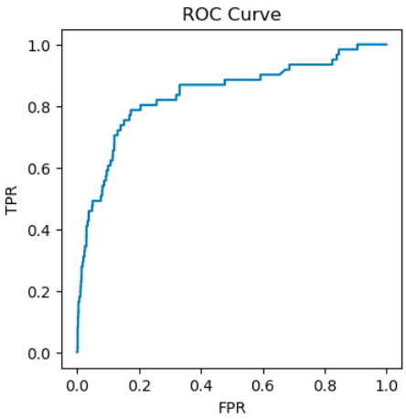
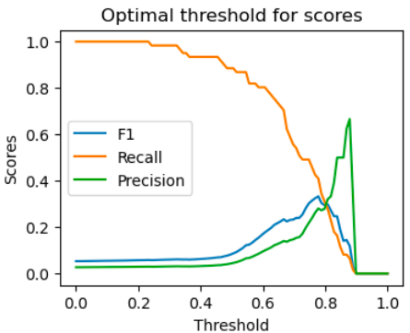
ArNet2 + ResNet Results HeartPy peak detection, all windows
AUC=0.838

Slide 24
ArNet2 + ResNet Confusion Matrix HeartPy peak detection, all windows
 | Predicted AF (PP) | Predicted Non-AF (PN)
AF (P) | 55 | 6
Non-AF (N) | 1405 | 755
Precision TP/PP | 0.037
Recall TP/P | 0.901
F1 2TP/(2TP+FP+FN) | 0.072

Slide 25
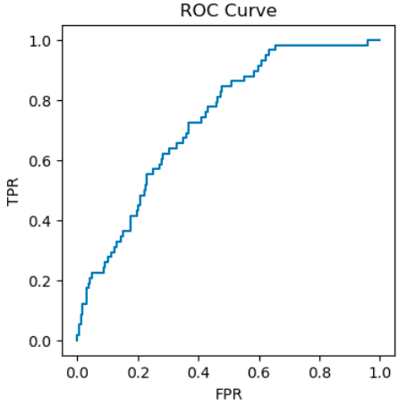
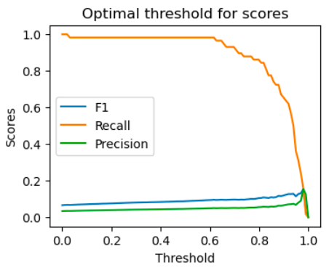
ResNet Results Elgendi peak detection
AUC=0.733

Slide 26
ResNet Confusion Matrix Elgendi peak detection
 | Predicted AF (PP) | Predicted Non-AF (PN)
AF (P) | 57 | 1
Non-AF (N) | 1170 | 470
Precision TP/PP | 0.046
Recall TP/P | 0.982
F1 2TP/(2TP+FP+FN) | 0.088

Slide 27
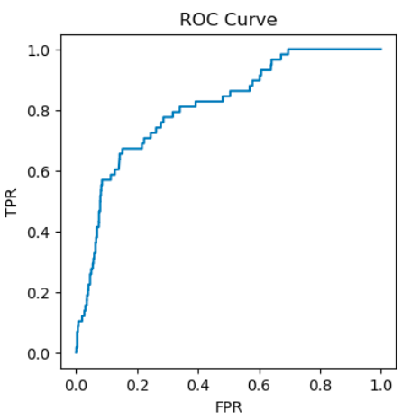
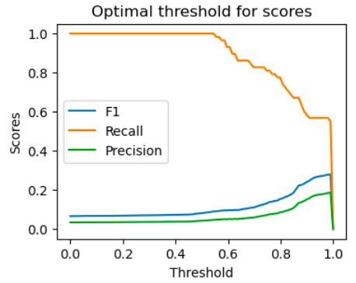
ArNet2 + ResNet Results Elgendi peak detection
AUC=0.81

Slide 28
ArNet2 + ResNet Confusion Matrix Elgendi peak detection
 | Predicted AF (PP) | Predicted Non-AF (PN)
AF (P) | 58 | 0
Non-AF (N) | 1385 | 255
Precision TP/PP | 0.04
Recall TP/P | 1.0
F1 2TP/(2TP+FP+FN) | 0.077

Slide 29
Results Summary
 | HeartPy |  | Elgendi
 | F1 | AUC | F1 | AUC
1D-CNN only | 0.118 | 0.837 | 0.086 | 0.739
ResNet only | 0.08 | 0.811 | 0.088 | 0.733
ArNet | 0.136 | 0.761 | 0.086 | 0.731
ArNet2 | 0.072 | 0.838 | 0.077 | 0.81

Slide 30
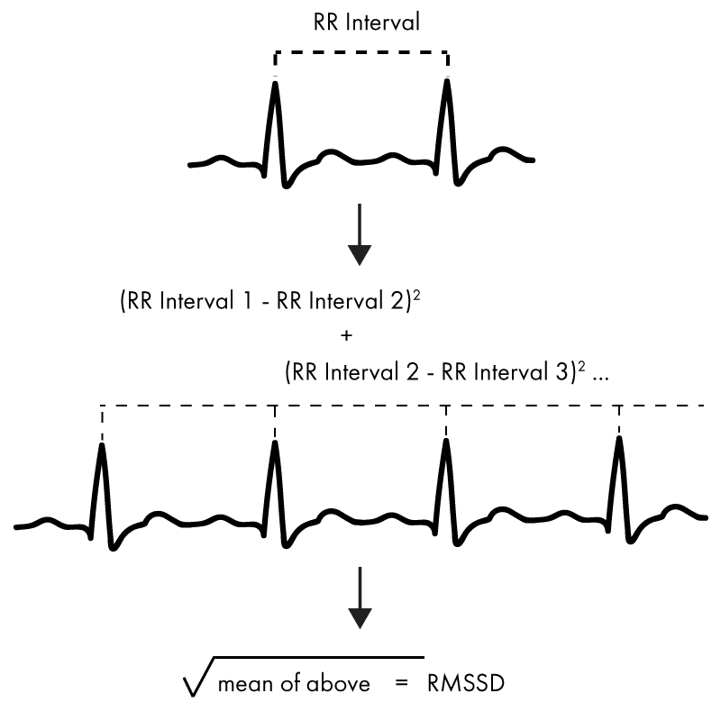
Signal Quality
In order to ignore “bad” windows, we need to measure the quality of each window using a Signal Quality Index.
There are variety of SQI for PPG signals, for example the Root Mean Squared of Successive Difference (RMSSD).
We have tried using RMSSD to improve performance, however there was a negligible improvement.

Slide 31
Summary
Out of the box, there a many false alarms
Highly imbalanced AF windows, therefore the performance we have presented should be taken with a grain of salt.
Next steps:
Improve the window filtering using SQI
Find more PPG data with AF annotation / Augmentation / Generation
Transfer learning using existing feature extraction (freezing)

